Slide 1
The DARK SIDE OF THE MOOSIC
Harmonizing Data and Melody: The Journey To Perfect Playlists

Slide 2
Table of contents
01
02
Setting the stage
Composing with clusters
03
04
Playlists: Hits and Misses
Encore
Introduction to the project’s objectives and background.
Melding Spotify’s Notes and K-means’ Beats.
The harmonies and the occasional off-key moments.
Our learnings and the symphony of future tunes.

Slide 3
Setting the stage

Slide 4
Set of songs
Divide into playlists
Songs per playlist
KEY questions and dataset
5000
Can Spotify’s audio features identify similar songs?
Is K-Means a good model to create playlists?
20 - 100
50 - 250

Slide 5
SPOTify’s audio features
Fine-tuning for the perfect melody.
danceability
energy
loudness
speechiness
tempo
acousticness
liveness
valence
Instrumentalness

Slide 6
SPOTify’s audio features
Fine-tuning for the perfect melody.
KEY
MODE
DURATION
TIME SIGNATURE

Slide 7
Composing with clusters

Slide 8
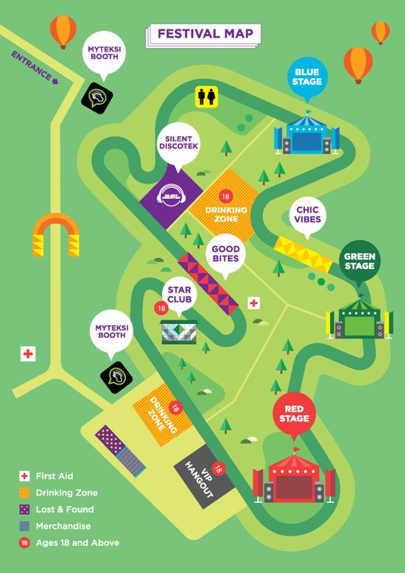
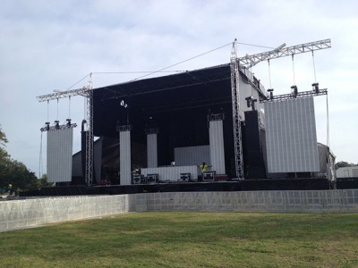
The science behind the sound
Notes:
Think of a massive music festival with various stages. Each stage features a particular genre – rock, jazz, country, electronic. As bands perform, they're assigned to the stage where their music fits best. K-means is like the festival organizer, determining which band (or song) goes to which stage based on their sound, ensuring everyone enjoys the music they love.
Imagine planning that massive music festival. You have the challenging task of deciding how many stages to set up. Too few stages, and genres get muddled together, making it hard for attendees to find the music they love. Too many stages, and the festival grounds might feel sparse or overwhelming, with too many choices and not enough energy at each stage. Just like in K-means, finding the right number of stages (or clusters) is essential. It ensures that the festival (or our playlists) offers a variety of distinct experiences without overwhelming or confusing the attendees (or listeners).

Slide 9
Playlists:
Hits and Misses

Slide 10
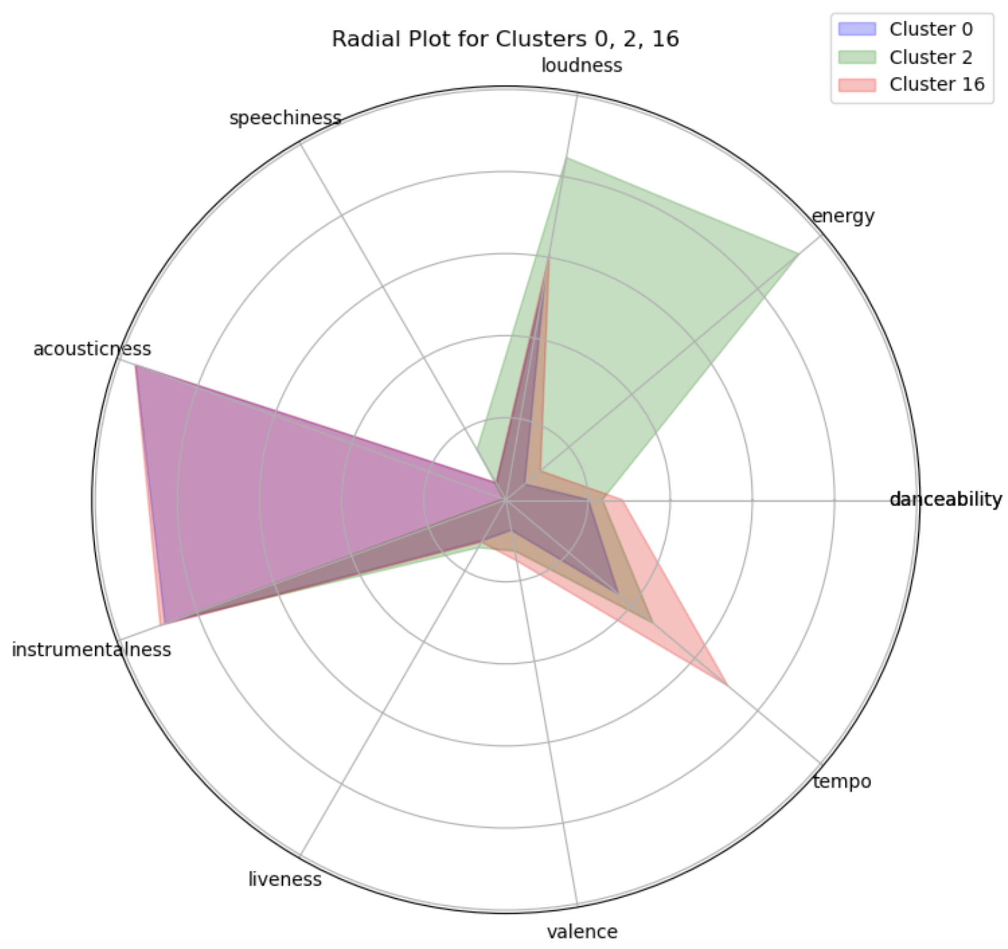

Playlists that struck the right chord
Classical SOngs
metal
Notes:
As you can see here, the plot shows the features of three clusters for which the algorithm worked well.
You can identify that the playlists have a couple of distinct features and the rest is quiet low. In this case the algorithm performed well.

Slide 11
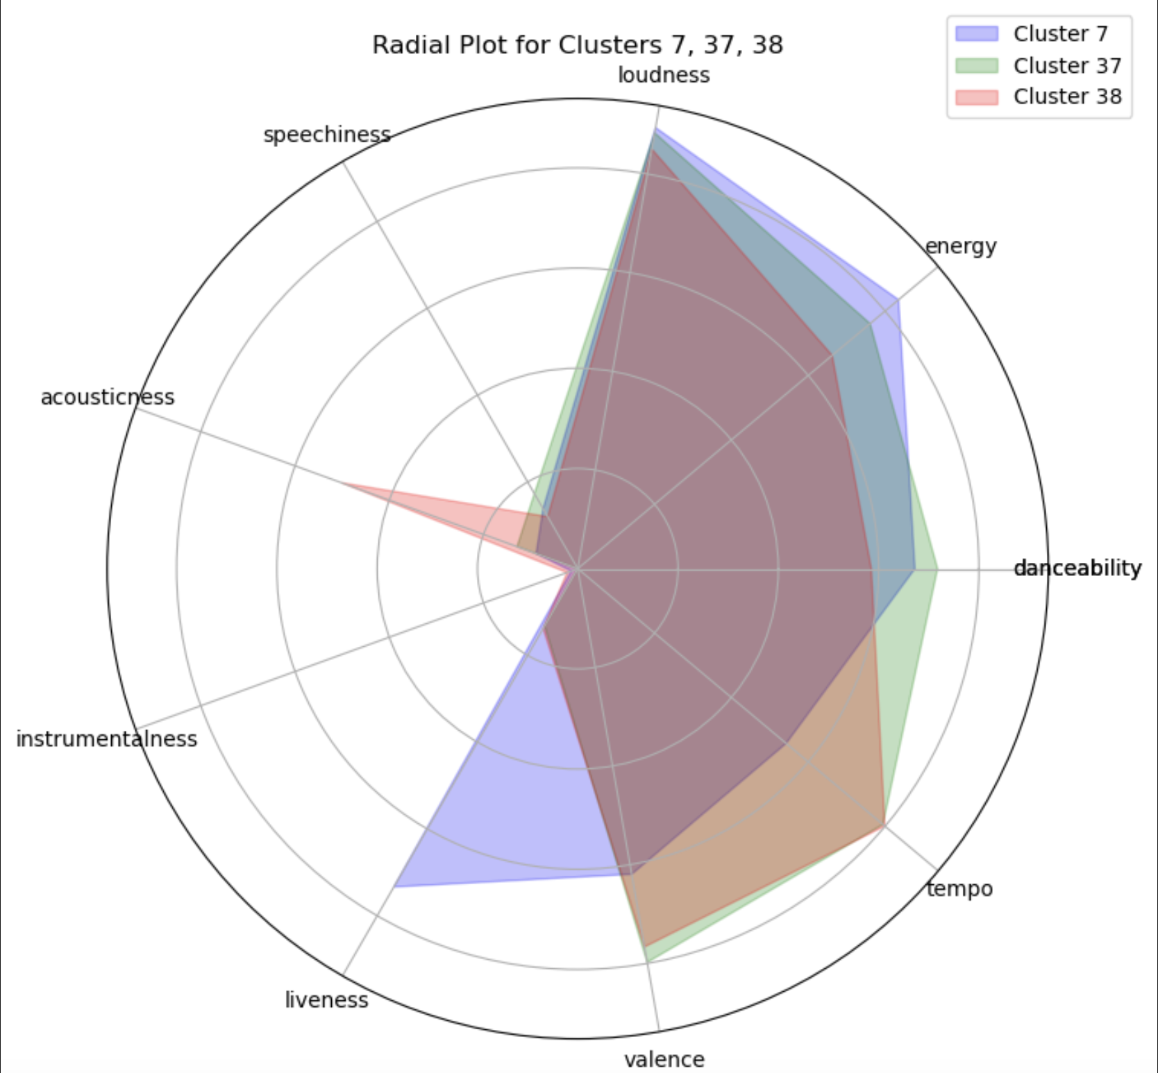
The surprise solos
Playlist 7
Songs:
Notes:
As you can see, the playlists for which the clustering didnt work well have many features being high and low.
Looking at the playlists we saw that this algorithm created 18 really good playlists and 30 playlists which had some surprising songs in them.

Slide 12
encore
Reflection & Rhythms Ahead

Slide 13
Distinct vs generic
18 30
Notes:
K-means works well for songs with distinct features but struggles to find meaning in generic songs. Maybe an extension of more features would solve this problem and find underlying connections between more fitting songs.
We also recommend to look at supervised learning, since we can use existing dataset to cluster the songs in our repertoire and make better predictions.
Lastly there are many more algorithms to look at.
Conclusion we can say, that the algorithm worked well for 18 out of 48 playlists and if we consider using this method we should carefully decide which songs to include in our dataset.

